Slide 1



Class 11: Unsupervised Learning: Clustering Analysis
UNIT III: Advanced Analytics and Machine Learning Models
Sebastián Muñoz-Herrera, PhD.
Héctor Hormazábal
Muñoz-Herrera and Hormazábal Class 11: Machine Learning - Clustering Analysis UNIT III: Advanced Analytics and Machine Learning Models

Slide 2
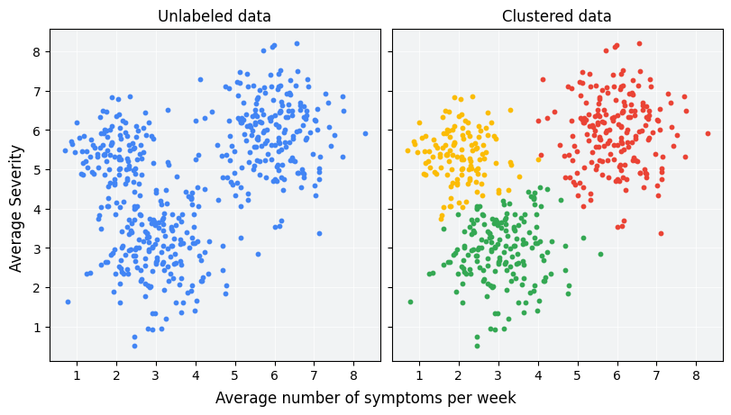
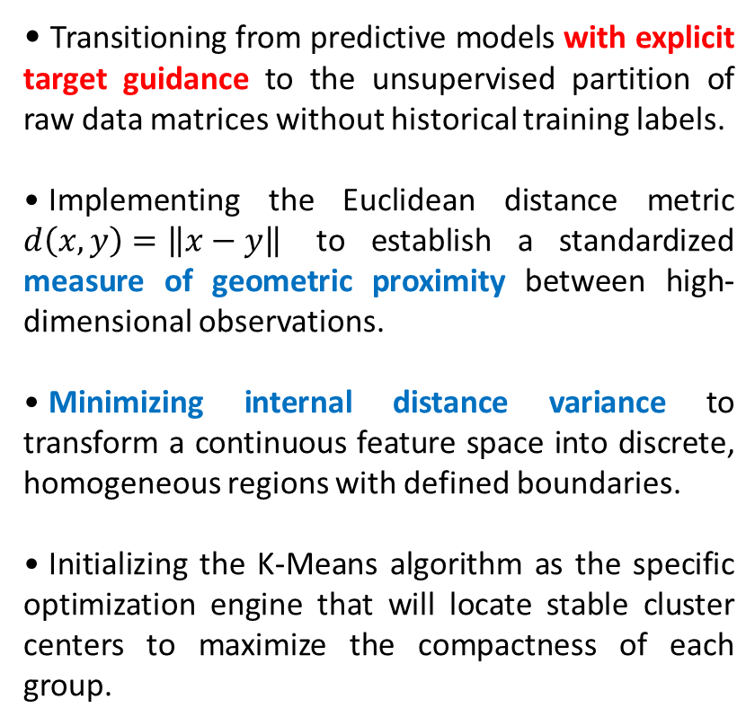
Unsupervised Learning - Foundations of Cluster Analysis
Transitioning from predictive models with explicit target guidance to the unsupervised partition of raw data matrices without historical training labels.
Implementing the Euclidean distance metric $d\left(x,y\right)=\left\|x−y\right\|$ to establish a standardized measure of geometric proximity between high-dimensional observations.
Minimizing internal distance variance to transform a continuous feature space into discrete, homogeneous regions with defined boundaries.
Initializing the K-Means algorithm as the specific optimization engine that will locate stable cluster centers to maximize the compactness of each group.
Muñoz-Herrera and Hormazábal Class 11: Machine Learning - Clustering Analysis UNIT III: Advanced Analytics and Machine Learning Models
Notes:
Let me walk you through the four units of the course so you know exactly where we're headed.
Unit I, which starts today, covers the Fundamentals of Business Intelligence — what it is, how it works, where data comes from.
Unit II moves into Data Preparation and Predictive Models — this is where you'll get your hands dirty cleaning and modeling data.
Unit III is the exciting one: Advanced Analytics and Machine Learning.
And Unit IV brings it all together with a focus on communicating insights ethically to support decision-making.
Notice how the course is structured like a pipeline: first you understand BI, then you prepare data, then you build models, and finally you communicate results. Each unit builds on the previous one — so keeping up with the pace really matters.
If at any point you feel lost, reach out early. We'd rather help you now than rescue you at the final exam.

Slide 3
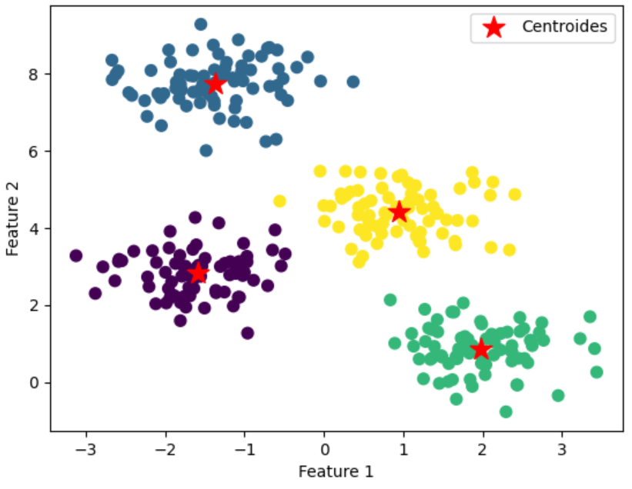
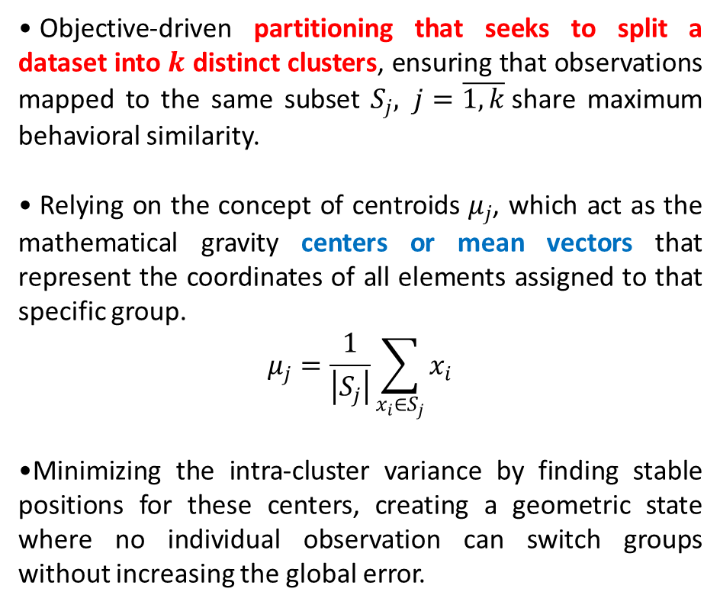
The Core Intuition of $K$-Means – Clustering ML method
Objective-driven partitioning that seeks to split a dataset into $k$ distinct clusters, ensuring that observations mapped to the same subset $S_{j}, j=\overline{1,k}$share maximum behavioral similarity.
Relying on the concept of centroids $μ_{j}$, which act as the mathematical gravity centers or mean vectors that represent the coordinates of all elements assigned to that specific group.
$$μ_{j}=\frac{1}{\left|S_{j}\right|}\sum_{x_{i}∈S_{j}}{x_{i}}$$
Minimizing the intra-cluster variance by finding stable positions for these centers, creating a geometric state where no individual observation can switch groups without increasing the global error.
Muñoz-Herrera and Hormazábal Class 11: Machine Learning - Clustering Analysis UNIT III: Advanced Analytics and Machine Learning Models
Notes:
Let me walk you through the four units of the course so you know exactly where we're headed.
Unit I, which starts today, covers the Fundamentals of Business Intelligence — what it is, how it works, where data comes from.
Unit II moves into Data Preparation and Predictive Models — this is where you'll get your hands dirty cleaning and modeling data.
Unit III is the exciting one: Advanced Analytics and Machine Learning.
And Unit IV brings it all together with a focus on communicating insights ethically to support decision-making.
Notice how the course is structured like a pipeline: first you understand BI, then you prepare data, then you build models, and finally you communicate results. Each unit builds on the previous one — so keeping up with the pace really matters.
If at any point you feel lost, reach out early. We'd rather help you now than rescue you at the final exam.

Slide 4
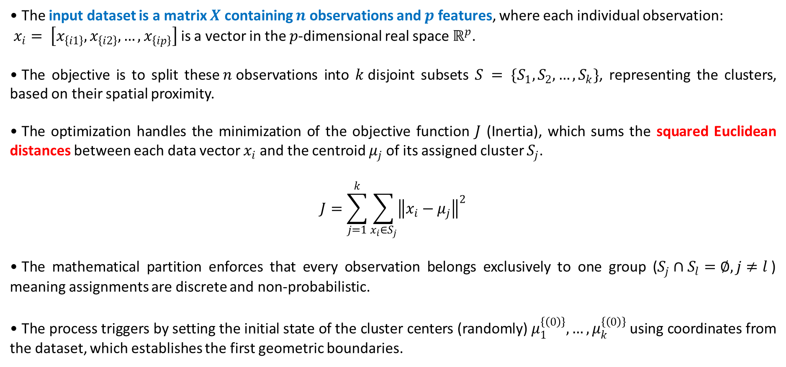
The $K$-Means Iterative Optimization
The input dataset is a matrix $X$ containing $n$observations and $p$ features, where each individual observation:
$x_{i}= \left[x_{\left\{i1\right\}}, x_{\left\{i2\right\}},…, x_{\left\{ip\right\}}\right]$is a vector in the $p$-dimensional real space $ℝ^{p}$.
The objective is to split these$n$observations into $k$disjoint subsets $S = \{S_{1}, S_{2}, …,S_{k}\}$, representing the clusters, based on their spatial proximity.
The optimization handles the minimization of the objective function $J$ (Inertia), which sums the squared Euclidean distances between each data vector $x_{i}$and the centroid $μ_{j}$of its assigned cluster $S_{j}$.
$$J=\sum_{j=1}^{k}{\sum_{x_{i}∈S_{j}}{{\left\|x_{i}−μ_{j}\right\|}^{2}}}$$
The mathematical partition enforces that every observation belongs exclusively to one group ($S_{j}∩S_{l}=∅, j≠l$) meaning assignments are discrete and non-probabilistic.
The process triggers by setting the initial state of the cluster centers (randomly) $μ_{1}^{\left\{\left(0\right)\right\}},…, μ_{k}^{\left\{\left(0\right)\right\}}$using coordinates from the dataset, which establishes the first geometric boundaries.
Muñoz-Herrera and Hormazábal Class 11: Machine Learning - Clustering Analysis UNIT III: Advanced Analytics and Machine Learning Models
Notes:
Let me walk you through the four units of the course so you know exactly where we're headed.
Unit I, which starts today, covers the Fundamentals of Business Intelligence — what it is, how it works, where data comes from.
Unit II moves into Data Preparation and Predictive Models — this is where you'll get your hands dirty cleaning and modeling data.
Unit III is the exciting one: Advanced Analytics and Machine Learning.
And Unit IV brings it all together with a focus on communicating insights ethically to support decision-making.
Notice how the course is structured like a pipeline: first you understand BI, then you prepare data, then you build models, and finally you communicate results. Each unit builds on the previous one — so keeping up with the pace really matters.
If at any point you feel lost, reach out early. We'd rather help you now than rescue you at the final exam.

Slide 5
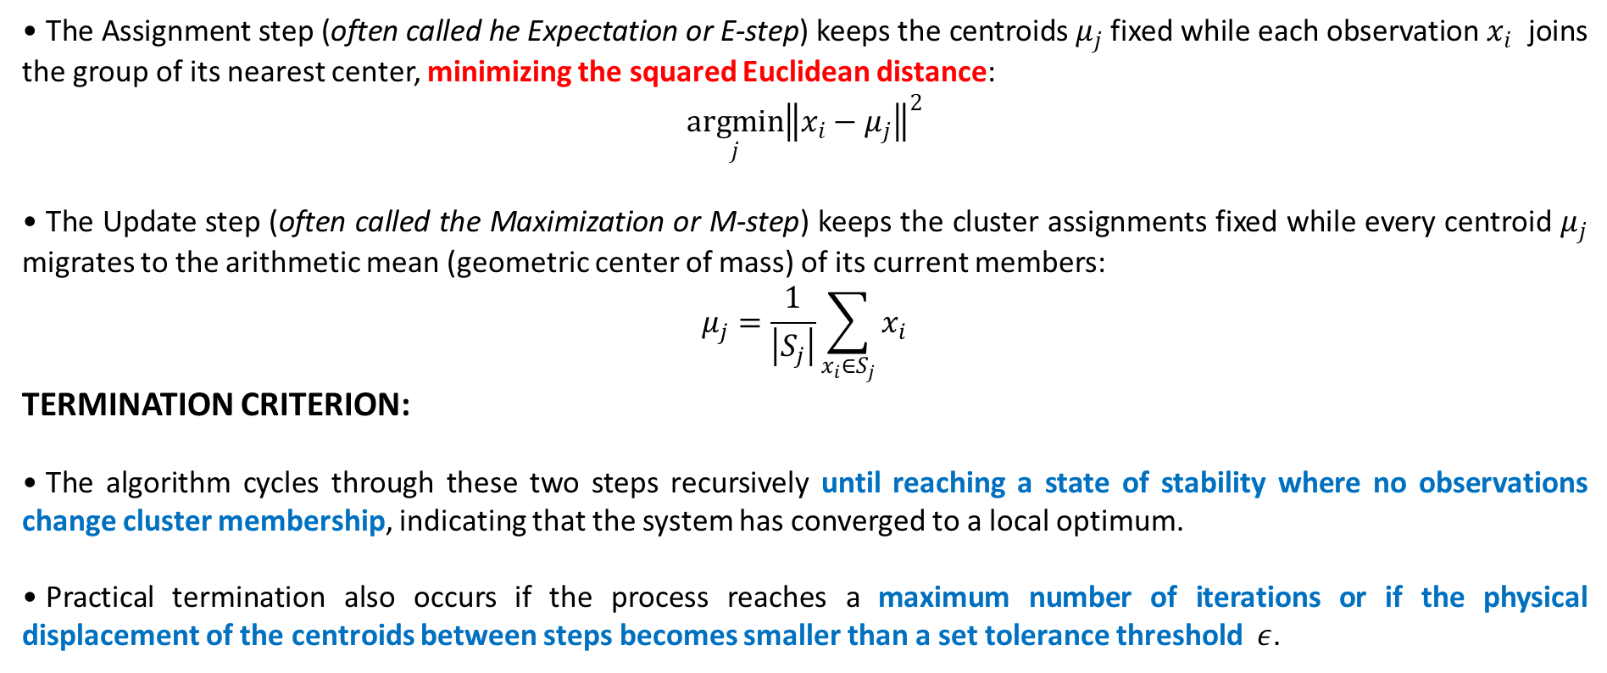
The Iterative Assignment and Update Cycle
The Assignment step (often called he Expectation or E-step) keeps the centroids $μ_{j}$fixed while each observation $x_{i}$ joins the group of its nearest center, minimizing the squared Euclidean distance:
$$\underset{j}{argmin}{{\left\|x_{i}−μ_{j}\right\|}^{2}}$$
The Update step (often called the Maximization or M-step) keeps the cluster assignments fixed while every centroid $μ_{j}$ migrates to the arithmetic mean (geometric center of mass) of its current members:
$$μ_{j}=\frac{1}{\left|S_{j}\right|}\sum_{x_{i}∈S_{j}}{x_{i}}$$
TERMINATION CRITERION:
The algorithm cycles through these two steps recursively until reaching a state of stability where no observations change cluster membership, indicating that the system has converged to a local optimum.
Practical termination also occurs if the process reaches a maximum number of iterations or if the physical displacement of the centroids between steps becomes smaller than a set tolerance threshold $ε$.
Muñoz-Herrera and Hormazábal Class 11: Machine Learning - Clustering Analysis UNIT III: Advanced Analytics and Machine Learning Models
Notes:
Let me walk you through the four units of the course so you know exactly where we're headed.
Unit I, which starts today, covers the Fundamentals of Business Intelligence — what it is, how it works, where data comes from.
Unit II moves into Data Preparation and Predictive Models — this is where you'll get your hands dirty cleaning and modeling data.
Unit III is the exciting one: Advanced Analytics and Machine Learning.
And Unit IV brings it all together with a focus on communicating insights ethically to support decision-making.
Notice how the course is structured like a pipeline: first you understand BI, then you prepare data, then you build models, and finally you communicate results. Each unit builds on the previous one — so keeping up with the pace really matters.
If at any point you feel lost, reach out early. We'd rather help you now than rescue you at the final exam.

Slide 6
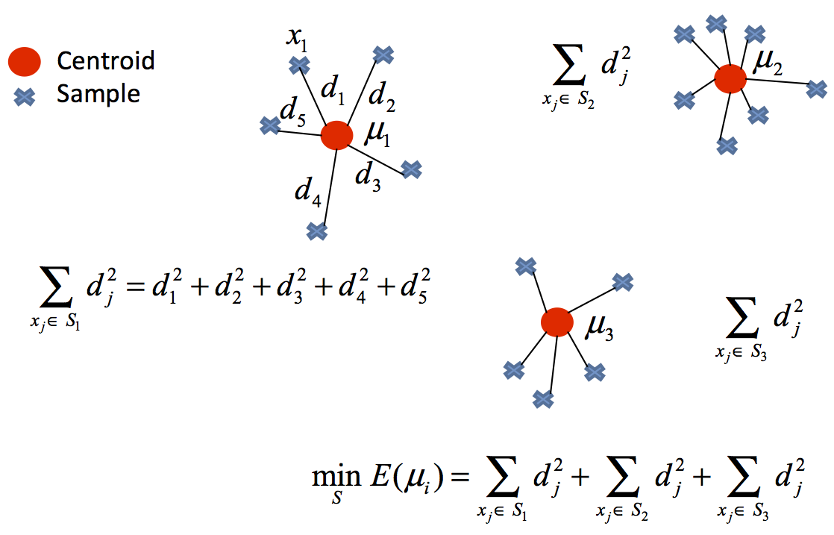
$K$-means. Initialization Sensitivity
Simultaneous optimization of discrete assignments and centroid coordinates results in a non-convex error surface with multiple local minima.
Random seeding limits the iterative trajectory to a local search space, often missing the global optimal partition.
Poorly placed initial centers cause high-density groups to be artificially split or merged.
To avoid these poor initial configurations, the algorithm can either be initialized strategically via K-Means++ (heuristic) or run multiple independent times.
Muñoz-Herrera and Hormazábal Class 11: Machine Learning - Clustering Analysis UNIT III: Advanced Analytics and Machine Learning Models
Notes:
Let me walk you through the four units of the course so you know exactly where we're headed.
Unit I, which starts today, covers the Fundamentals of Business Intelligence — what it is, how it works, where data comes from.
Unit II moves into Data Preparation and Predictive Models — this is where you'll get your hands dirty cleaning and modeling data.
Unit III is the exciting one: Advanced Analytics and Machine Learning.
And Unit IV brings it all together with a focus on communicating insights ethically to support decision-making.
Notice how the course is structured like a pipeline: first you understand BI, then you prepare data, then you build models, and finally you communicate results. Each unit builds on the previous one — so keeping up with the pace really matters.
If at any point you feel lost, reach out early. We'd rather help you now than rescue you at the final exam.

Slide 7
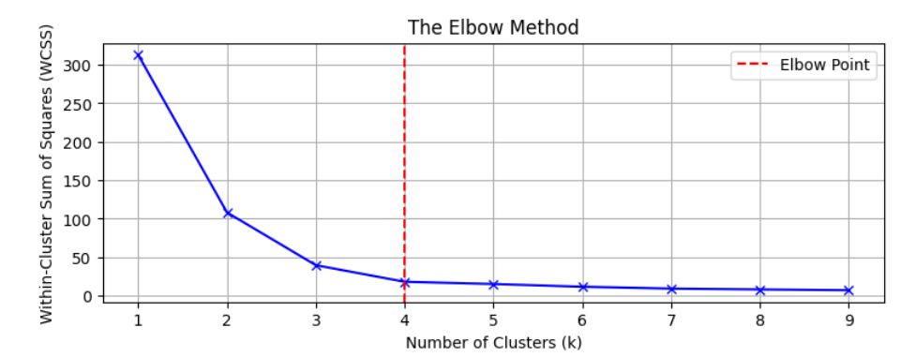
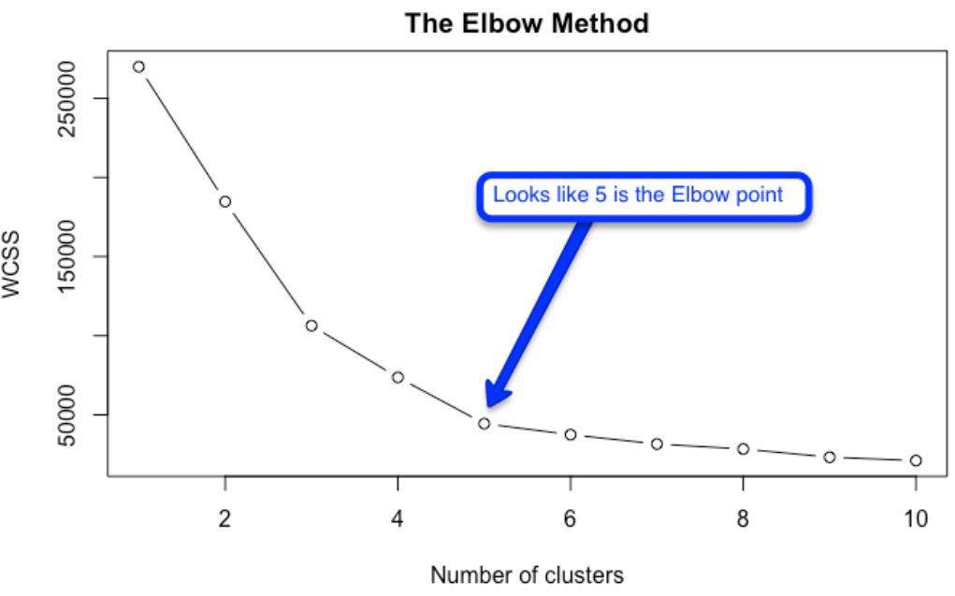
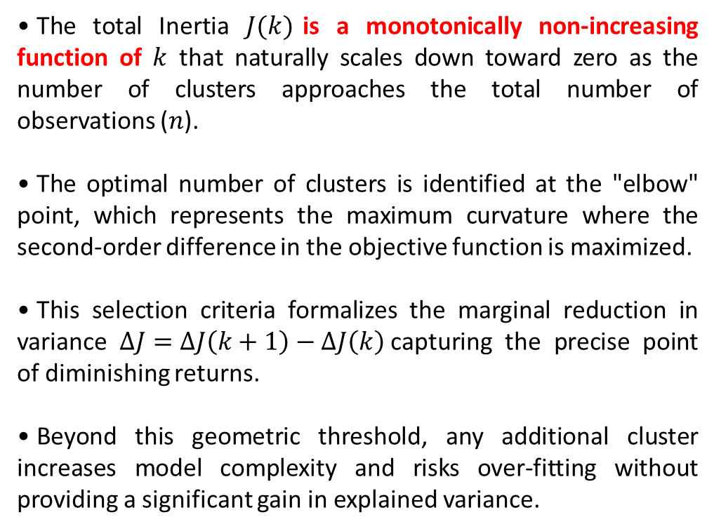
Optimal $K$Selection: The Elbow Method
The total Inertia $J(k)$is a monotonically non-increasing function of $k$ that naturally scales down toward zero as the number of clusters approaches the total number of observations ($n$).
The optimal number of clusters is identified at the "elbow" point, which represents the maximum curvature where the second-order difference in the objective function is maximized.
This selection criteria formalizes the marginal reduction in variance $ΔJ=ΔJ\left(k+1\right)−ΔJ\left(k\right)$capturing the precise point of diminishing returns.
Beyond this geometric threshold, any additional cluster increases model complexity and risks over-fitting without providing a significant gain in explained variance.
Muñoz-Herrera and Hormazábal Class 11: Machine Learning - Clustering Analysis UNIT III: Advanced Analytics and Machine Learning Models
Notes:
Let me walk you through the four units of the course so you know exactly where we're headed.
Unit I, which starts today, covers the Fundamentals of Business Intelligence — what it is, how it works, where data comes from.
Unit II moves into Data Preparation and Predictive Models — this is where you'll get your hands dirty cleaning and modeling data.
Unit III is the exciting one: Advanced Analytics and Machine Learning.
And Unit IV brings it all together with a focus on communicating insights ethically to support decision-making.
Notice how the course is structured like a pipeline: first you understand BI, then you prepare data, then you build models, and finally you communicate results. Each unit builds on the previous one — so keeping up with the pace really matters.
If at any point you feel lost, reach out early. We'd rather help you now than rescue you at the final exam.

Slide 8
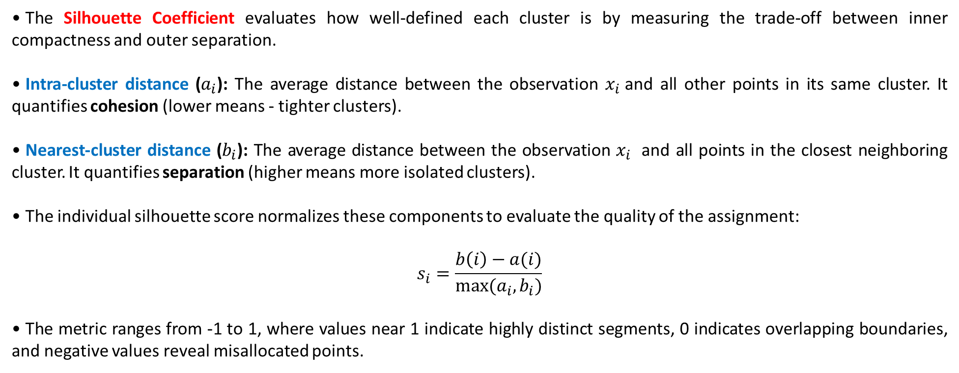
Validation via Silhouette Analysis
The Silhouette Coefficient evaluates how well-defined each cluster is by measuring the trade-off between inner compactness and outer separation.
Intra-cluster distance ($a_{i}$): The average distance between the observation $x_{i}$and all other points in its same cluster. It quantifies cohesion (lower means - tighter clusters).
Nearest-cluster distance ($b_{i}$): The average distance between the observation $x_{i}$ and all points in the closest neighboring cluster. It quantifies separation (higher means more isolated clusters).
The individual silhouette score normalizes these components to evaluate the quality of the assignment:
$$s_{i}=\frac{b\left(i\right)−a(i)}{max⁡(a_{i},b_{i})}$$
The metric ranges from -1 to 1, where values near 1 indicate highly distinct segments, 0 indicates overlapping boundaries, and negative values reveal misallocated points.
Muñoz-Herrera and Hormazábal Class 11: Machine Learning - Clustering Analysis UNIT III: Advanced Analytics and Machine Learning Models
Notes:
Let me walk you through the four units of the course so you know exactly where we're headed.
Unit I, which starts today, covers the Fundamentals of Business Intelligence — what it is, how it works, where data comes from.
Unit II moves into Data Preparation and Predictive Models — this is where you'll get your hands dirty cleaning and modeling data.
Unit III is the exciting one: Advanced Analytics and Machine Learning.
And Unit IV brings it all together with a focus on communicating insights ethically to support decision-making.
Notice how the course is structured like a pipeline: first you understand BI, then you prepare data, then you build models, and finally you communicate results. Each unit builds on the previous one — so keeping up with the pace really matters.
If at any point you feel lost, reach out early. We'd rather help you now than rescue you at the final exam.

Slide 9
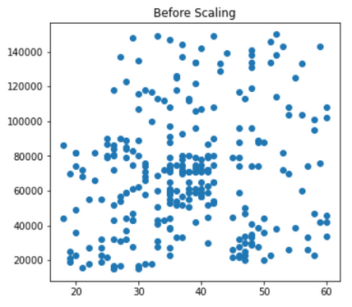
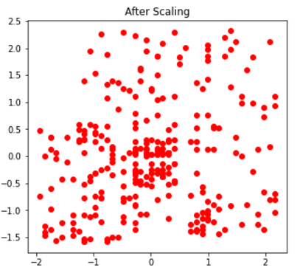
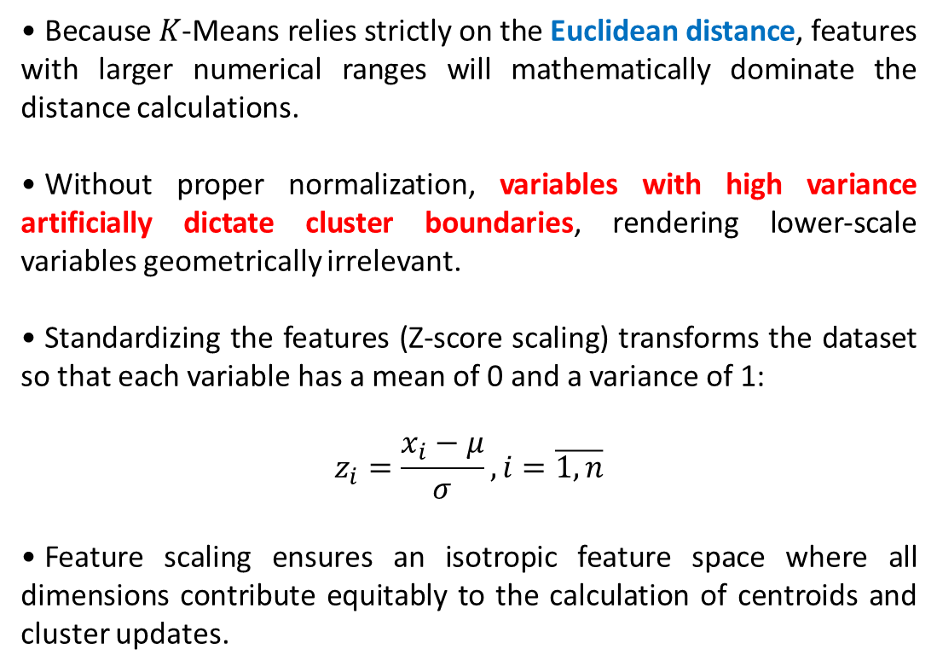
Critical Pre-processing: Data Scaling - Z score
Because $K$-Means relies strictly on the Euclidean distance, features with larger numerical ranges will mathematically dominate the distance calculations.
Without proper normalization, variables with high variance artificially dictate cluster boundaries, rendering lower-scale variables geometrically irrelevant.
Standardizing the features (Z-score scaling) transforms the dataset so that each variable has a mean of 0 and a variance of 1:
$$z_{i}=\frac{x_{i}−μ}{σ}, i=\overline{1,n}$$
Feature scaling ensures an isotropic feature space where all dimensions contribute equitably to the calculation of centroids and cluster updates.
Muñoz-Herrera and Hormazábal Class 11: Machine Learning - Clustering Analysis UNIT III: Advanced Analytics and Machine Learning Models
Notes:
Let me walk you through the four units of the course so you know exactly where we're headed.
Unit I, which starts today, covers the Fundamentals of Business Intelligence — what it is, how it works, where data comes from.
Unit II moves into Data Preparation and Predictive Models — this is where you'll get your hands dirty cleaning and modeling data.
Unit III is the exciting one: Advanced Analytics and Machine Learning.
And Unit IV brings it all together with a focus on communicating insights ethically to support decision-making.
Notice how the course is structured like a pipeline: first you understand BI, then you prepare data, then you build models, and finally you communicate results. Each unit builds on the previous one — so keeping up with the pace really matters.
If at any point you feel lost, reach out early. We'd rather help you now than rescue you at the final exam.

Slide 10
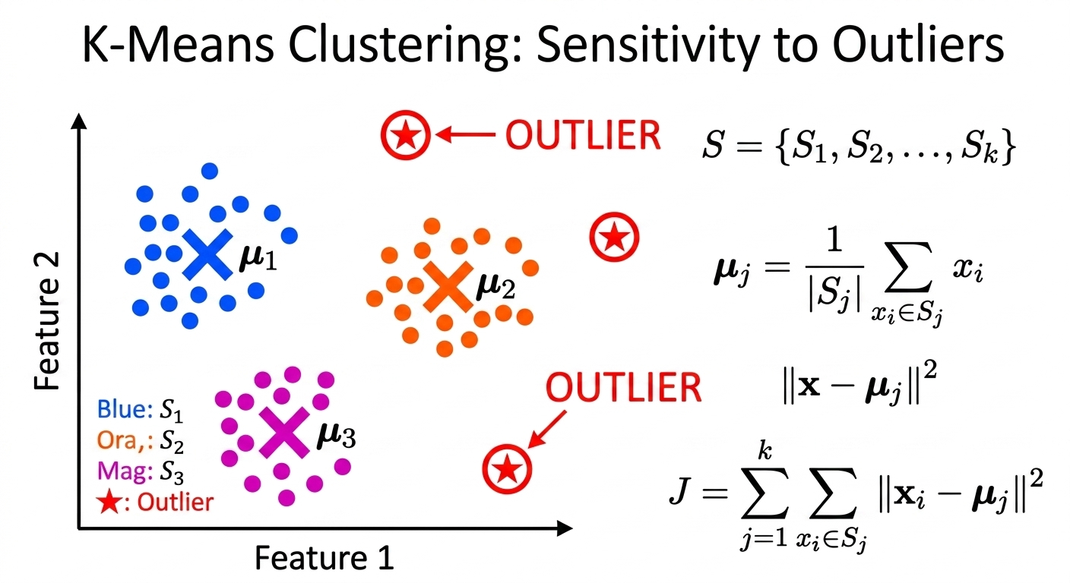
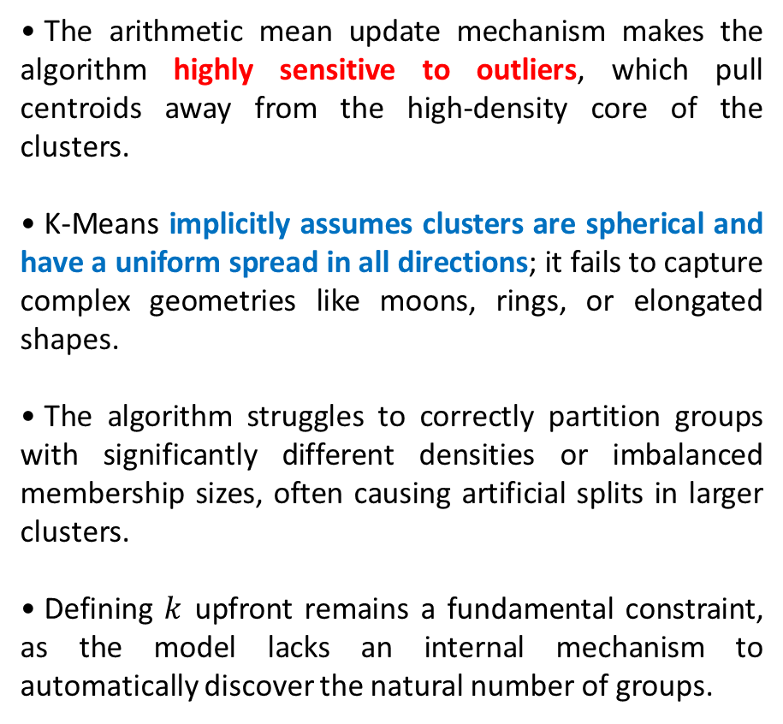
Algorithm Limitations and Geometric Assumptions
The arithmetic mean update mechanism makes the algorithm highly sensitive to outliers, which pull centroids away from the high-density core of the clusters.
K-Means implicitly assumes clusters are spherical and have a uniform spread in all directions; it fails to capture complex geometries like moons, rings, or elongated shapes.
The algorithm struggles to correctly partition groups with significantly different densities or imbalanced membership sizes, often causing artificial splits in larger clusters.
Defining $k$ upfront remains a fundamental constraint, as the model lacks an internal mechanism to automatically discover the natural number of groups.
Muñoz-Herrera and Hormazábal Class 11: Machine Learning - Clustering Analysis UNIT III: Advanced Analytics and Machine Learning Models
Notes:
Let me walk you through the four units of the course so you know exactly where we're headed.
Unit I, which starts today, covers the Fundamentals of Business Intelligence — what it is, how it works, where data comes from.
Unit II moves into Data Preparation and Predictive Models — this is where you'll get your hands dirty cleaning and modeling data.
Unit III is the exciting one: Advanced Analytics and Machine Learning.
And Unit IV brings it all together with a focus on communicating insights ethically to support decision-making.
Notice how the course is structured like a pipeline: first you understand BI, then you prepare data, then you build models, and finally you communicate results. Each unit builds on the previous one — so keeping up with the pace really matters.
If at any point you feel lost, reach out early. We'd rather help you now than rescue you at the final exam.

Slide 11
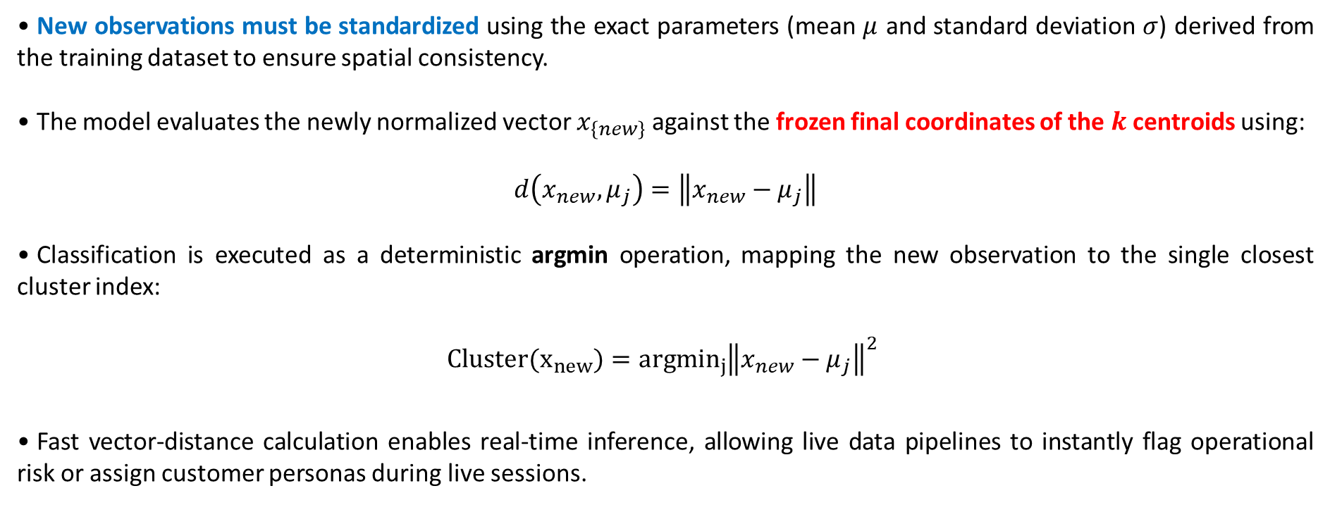
K-Means Inference and Prediction Architecture
New observations must be standardized using the exact parameters (mean $μ$ and standard deviation $σ$) derived from the training dataset to ensure spatial consistency.
The model evaluates the newly normalized vector $x_{\left\{new\right\}}$ against the frozen final coordinates of the $k$ centroids using:
$$d\left(x_{new},μ_{j}\right)=\left\|x_{new}−μ_{j}\right\|$$
Classification is executed as a deterministic argmin operation, mapping the new observation to the single closest cluster index:
$$\underset{}{Cluster(x_{new})={argmin}_{j}}{{\left\|x_{new}−μ_{j}\right\|}^{2} }$$
Fast vector-distance calculation enables real-time inference, allowing live data pipelines to instantly flag operational risk or assign customer personas during live sessions.
Muñoz-Herrera and Hormazábal Class 11: Machine Learning - Clustering Analysis UNIT III: Advanced Analytics and Machine Learning Models
Notes:
Let me walk you through the four units of the course so you know exactly where we're headed.
Unit I, which starts today, covers the Fundamentals of Business Intelligence — what it is, how it works, where data comes from.
Unit II moves into Data Preparation and Predictive Models — this is where you'll get your hands dirty cleaning and modeling data.
Unit III is the exciting one: Advanced Analytics and Machine Learning.
And Unit IV brings it all together with a focus on communicating insights ethically to support decision-making.
Notice how the course is structured like a pipeline: first you understand BI, then you prepare data, then you build models, and finally you communicate results. Each unit builds on the previous one — so keeping up with the pace really matters.
If at any point you feel lost, reach out early. We'd rather help you now than rescue you at the final exam.

Slide 12

Practical Section
Google Colab — RFM Clustering
K means ML algorithm
Cluster generation + Business impact
Evaluation metrics and final centroids
Visualization – Elbow method
Muñoz-Herrera and Hormazábal Class 11: Machine Learning - Clustering Analysis UNIT III: Advanced Analytics and Machine Learning Models

Slide 13
Class 11: Unsupervised Learning: Clustering Analysis
UNIT III: Advanced Analytics and Machine Learning Models
Sebastián Muñoz-Herrera, PhD.
Héctor Hormazábal
Muñoz-Herrera and Hormazábal Class 11: Machine Learning - Clustering Analysis UNIT III: Advanced Analytics and Machine Learning Models

